Slide 2
Simulation programming
Presented by Iain Broomell

Slide 3
Contents
Introduction​
Use cases
​Code examples
How to​
Summary

Slide 4
Introduction
Simulation programming is the practice of testing a specific situation through a computer program. Simulators can be used for low-cost scientific testing, proof of concepts, and training purposes.

Slide 5
Use Cases
Product testing
Physics simulations
Nature
Population growth
Training

Slide 6
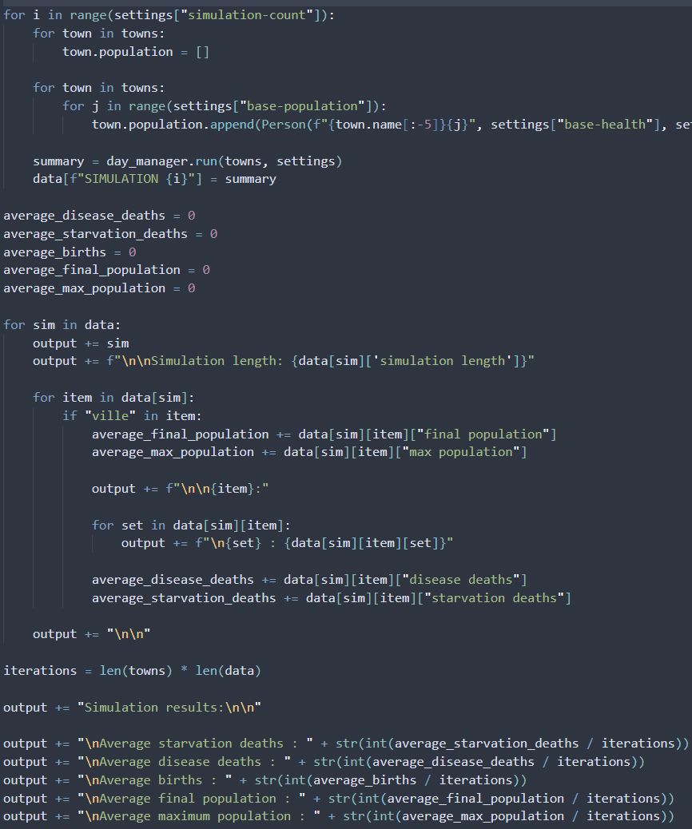
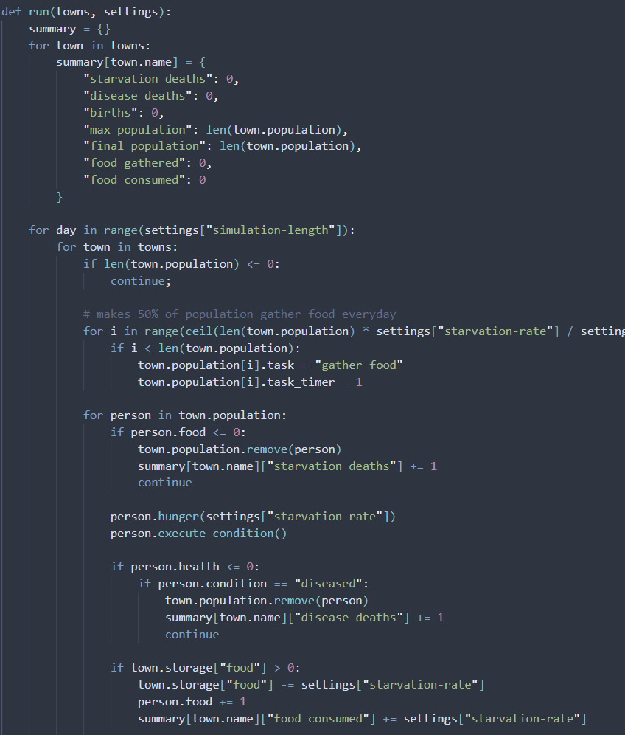
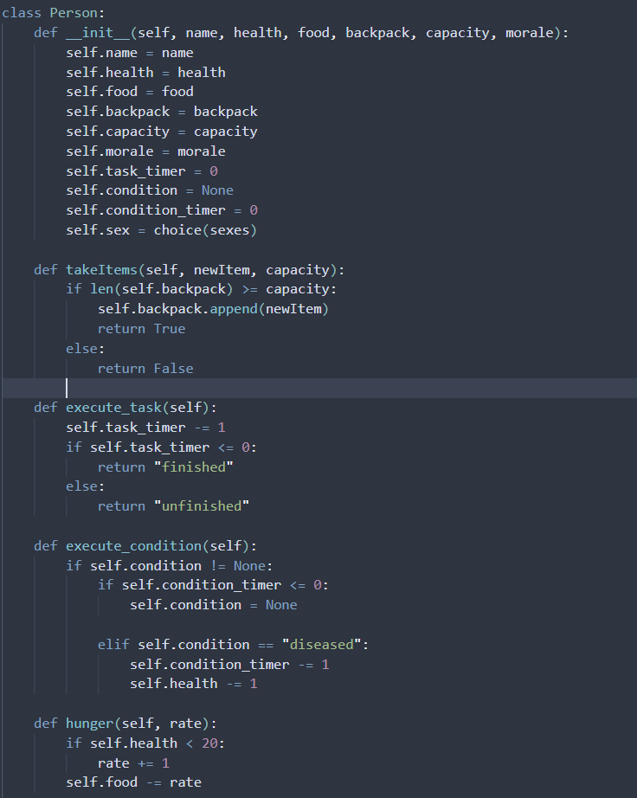
Code examples

Slide 7



How to
Determination phase
Design phase
Testing phase
Create a question concerning a specific situation
Brainstorm factors which influence situational outcome
Create initial base models to test functionality
Reach desired output, accounting for all variables and factors
Test different input cases and assess outcomes
Determine if the original question has been answered, and if data is sufficient and clear
Redesign if necessary, and repeat!

Slide 8
SUMMARY
Real world uses
Fun!

Slide 9
Simulation programming
Presented by Iain Broomell

